Slide 1
Weather Tools, Air Masses, Fronts, and Storms

Slide 2
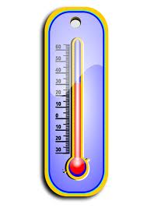
What weather tool measures the temperature of the air?

Slide 3
What weather tool measures the temperature of the air?
thermometer

Slide 4
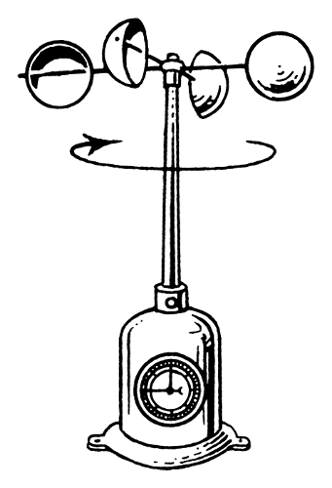
What weather tool measures wind speed?

Slide 5
What weather tool measures wind speed?
anemometer

Slide 6
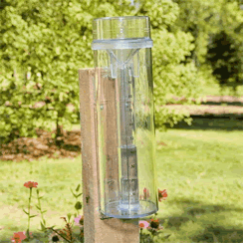
What weather tool measures the amount of rain?

Slide 7
What weather tool measures the amount of rain?
rain gauge

Slide 8
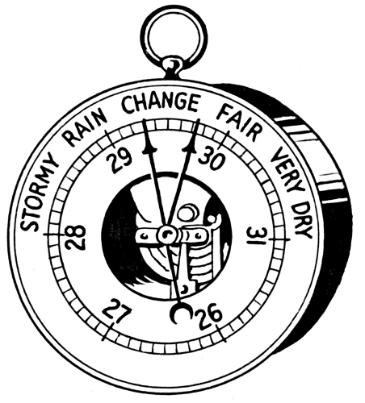
What weather tool measures air pressure?

Slide 9
What weather tool measures air pressure?
barometer

Slide 10
What are large areas of air with nearly the same temperature and moisture called?

Slide 11
What are large areas of air with nearly the same temperature and moisture called?
air masses

Slide 12
Air masses are very large regions of air with the same __________.

Slide 13
Air masses are very large regions of air with the same weather.

Slide 14
Air masses are always ________.

Slide 15
Air masses are always moving.

Slide 16
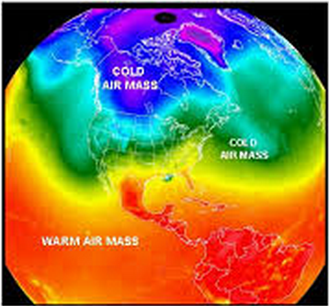
As an air mass moves, it brings the _________ with it.

Slide 17
As an air mass moves, it brings the weather with it.

Slide 18
What is the area where two air masses meet called?

Slide 19
What is the area where two air masses meet called?
fronts

Slide 20
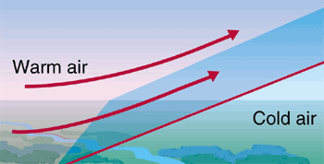
A front is a boundary between air masses that have different _______________.

Slide 21
A front is a boundary between air masses that have different temperatures.

Slide 22
Fronts usually bring changing _________ and may cause strong ________.

Slide 23
Fronts usually bring changing weather and may cause strong storms.

Slide 24
What three differences in air masses can cause storms when the air masses meet?

Slide 25
What three differences in air masses can cause storms when the air masses meet?
temperature
humidity
air pressure

Slide 26
What kind of storm?
Winds can blow 74 to over 186 miles per hour.

Slide 27
What kind of storm?
Winds can blow 74 to over 186 miles per hour.
hurricane

Slide 28
What kind of storm?
It can travel up to 497 miles per hour.

Slide 29
What kind of storm?
It can travel up to 497 miles per hour.
tornado

Slide 30
What kind of storm?
It forms in warm, moist air masses above warm ocean water.

Slide 31
What kind of storm?
It forms in warm, moist air masses above warm ocean water.
hurricane

Slide 32
What kind of storm?
It is a column of dark, spinning, twisting air.

Slide 33
What kind of storm?
It is a column of dark, spinning, twisting air.
tornado

Slide 34
What kind of storm?
It happens when warm air rises and cools rapidly.

Slide 35
What kind of storm?
It happens when warm air rises and cools rapidly.
thunderstorm

Slide 36
What kind of storm?
It begins when air masses with big temperature differences meet.

Slide 37
What kind of storm?
It begins when air masses with big temperature differences meet.
tornado

Slide 38
What kind of storm?
Cumulonimbus clouds create lightning and rain.

Slide 39
What kind of storm?
Cumulonimbus clouds create lightning and rain.
thunderstorm

Slide 40
What kind of storm?
As much as 10 inches of rain can fall in one day.

Slide 41
What kind of storm?
As much as 10 inches of rain can fall in one day.
hurricane

